Slide 1

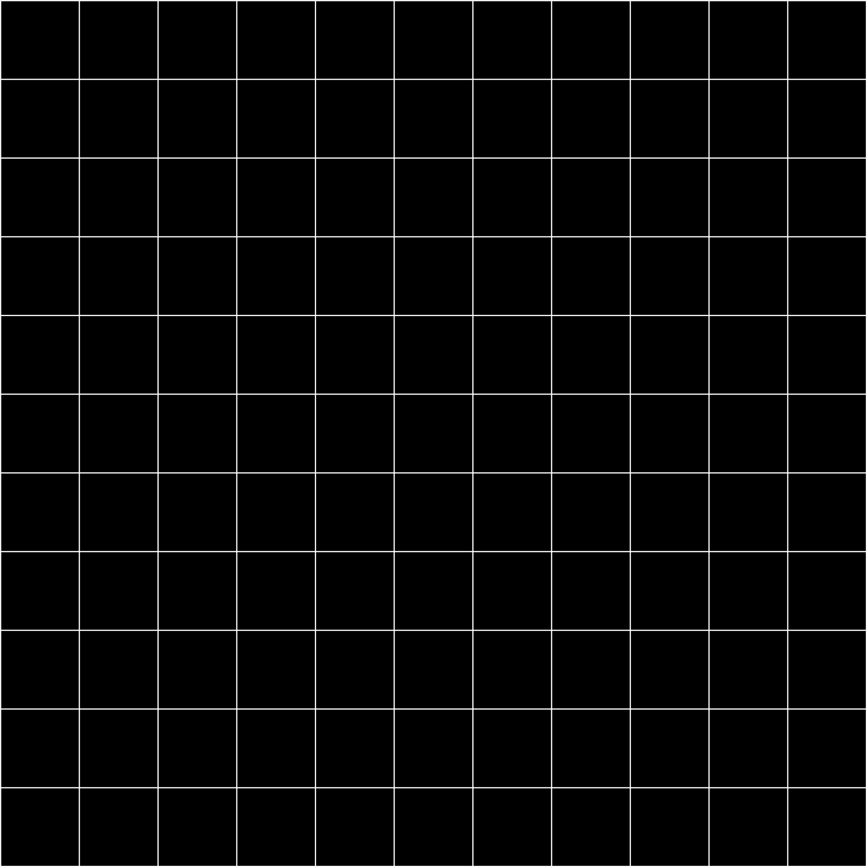



SKYHIGH
AIRLINES
Developed using ASP.NET Core MVC,Entity FrameWork & SQL Server
Presented By
Gnana Prasanna.M
Sneha Latha Reddy.K
Hema Ponakala
Guided by
Mr. Arvind Kumar

Slide 2
PROJECT OVERVIEW
SkyHigh Airlines Reservation System is a full-stack web application designed to simplify and digitize the entire flight booking process.
The system allows users to register, search for flights, select seats, book tickets, and make secure online payments. It also provides features like ticket cancellation, offer viewing, and chatbot assistance for queries.
Technologies Used :
Frontend: HTML, CSS, Bootstrap, Razor Views
Backend: ASP.NET Core MVC
Database: SQL Server with Entity Framework Core
Language: C#
Tools: Visual Studio 2022

Slide 3
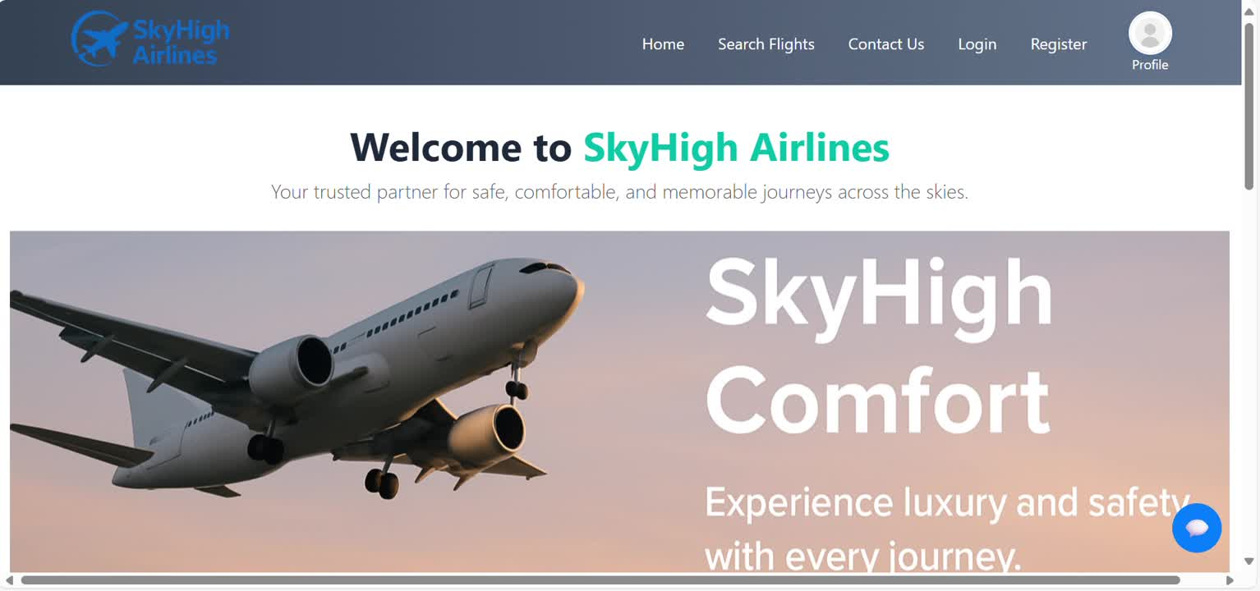
HOME PAGE
The Home Page video showcases dynamic sliders, featured offers, reasons to choose SkyHigh, and an elegant footer providing users a complete, space engaging first impression of the airline system.

Slide 4
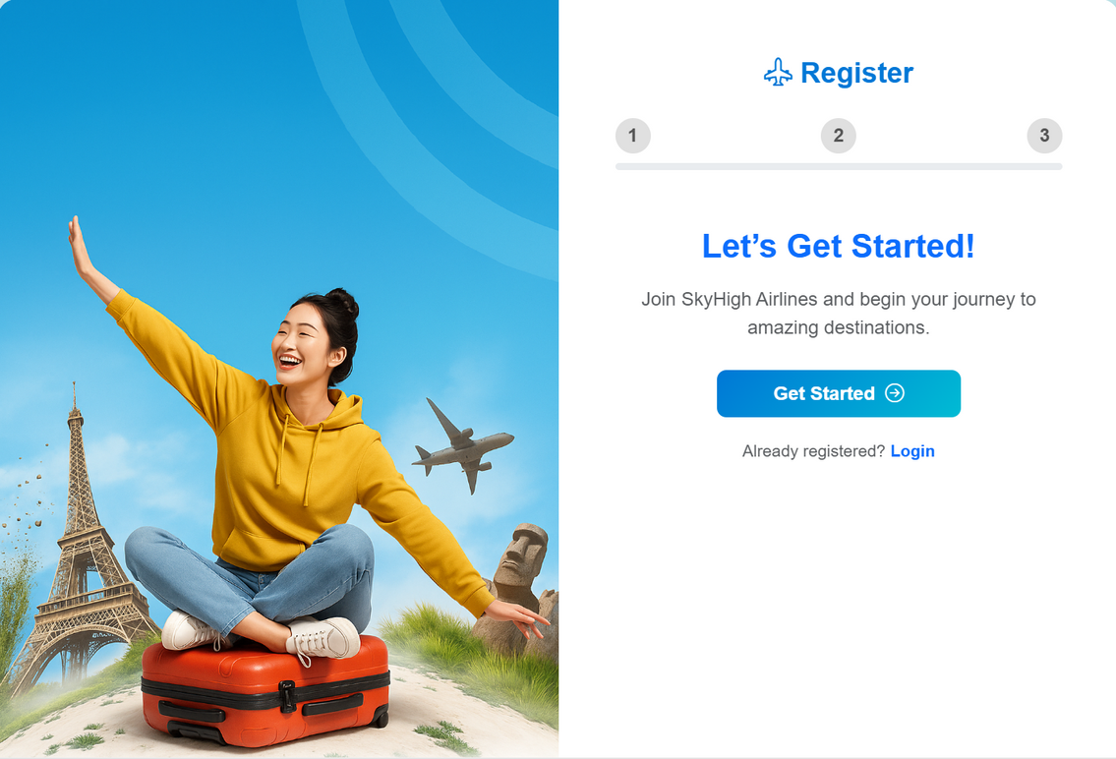
REGISTRATION PAGE
The Registration Page demonstrates the complete signup process with proper form validations, ensuring users enter accurate and required details before account creation.

Slide 5
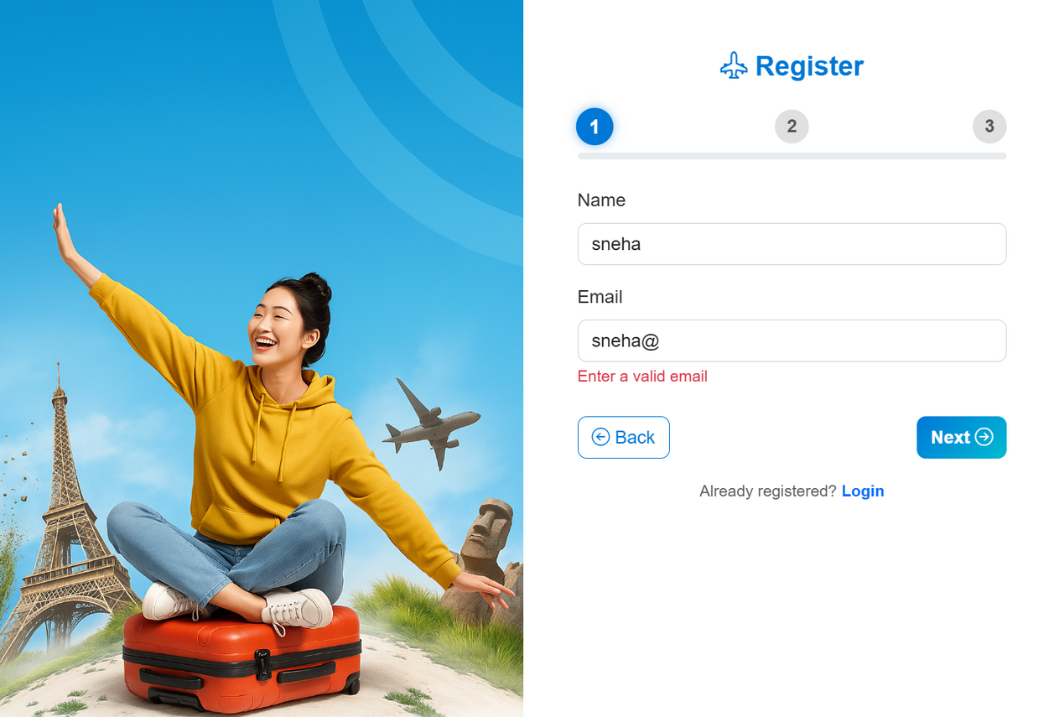
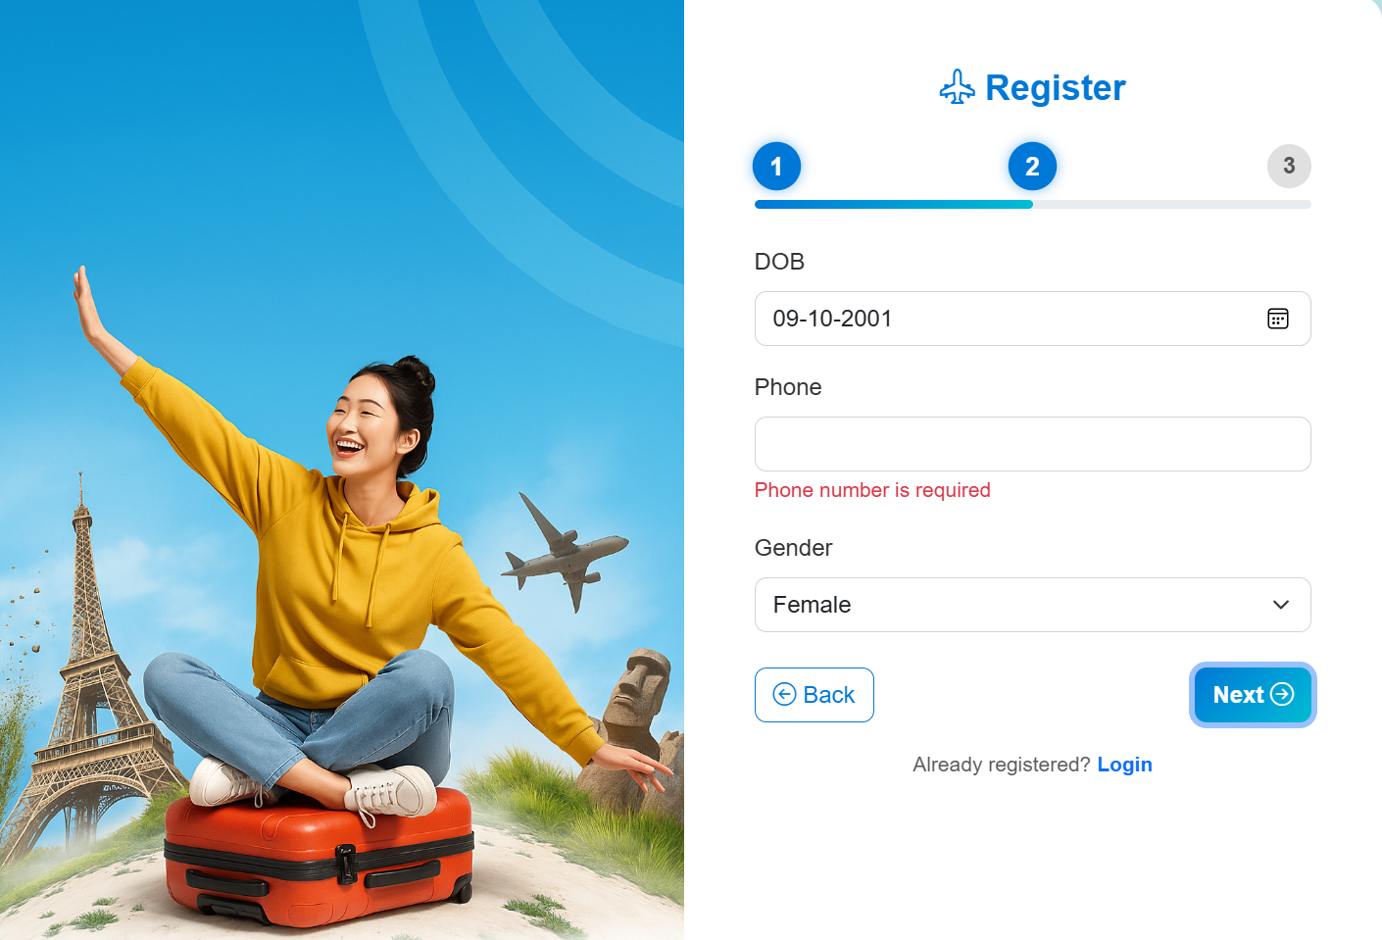
Displays an error message when an invalid email format is entered during registration.
Prompts a validation error if the phone number field is left empty or incorrect.

Slide 6
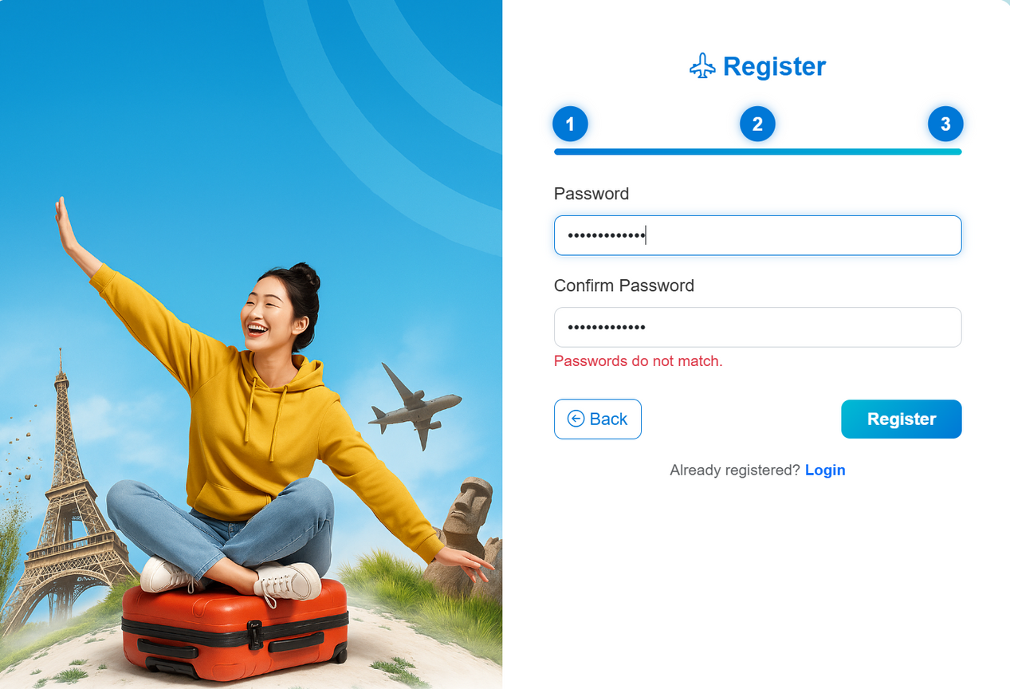
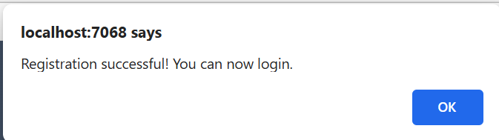
During registration, the system ensures data accuracy by validating the entered passwords. If the passwords do not match, a clear error message is displayed, prompting the user to correct the input before proceeding. This validation feature helps maintain account security and prevents incorrect submissions.
Displays a confirmation message once registration is successfully completed.

Slide 7
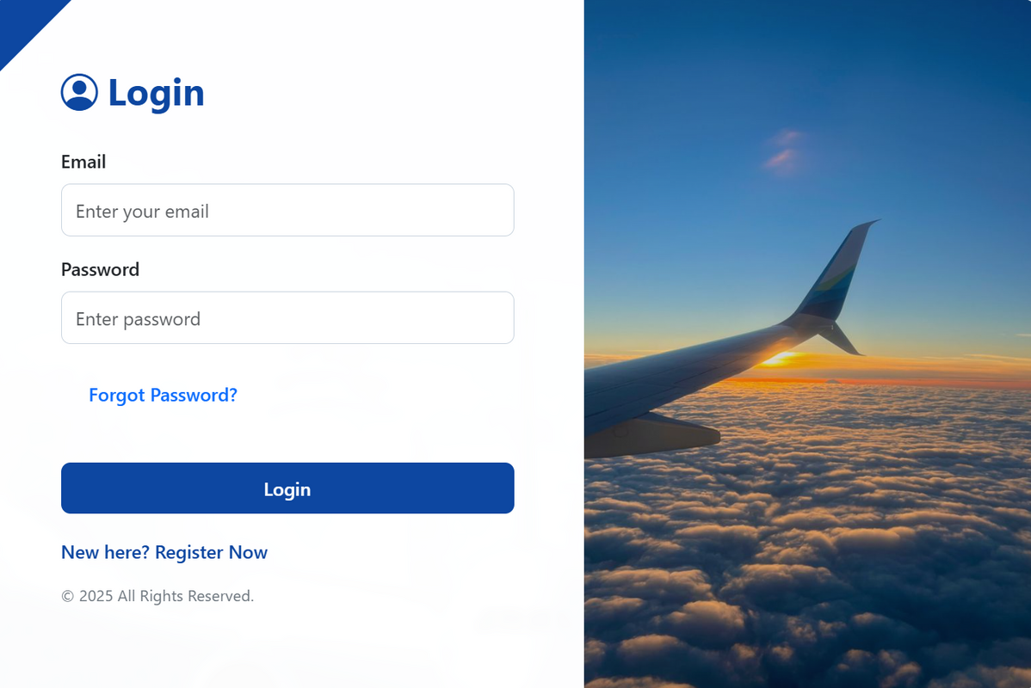
LOGIN PAGE
The Login Page allows registered users to securely access their accounts by entering valid cedentials,with a clean interface and role-based authentication for users and admins.

Slide 8
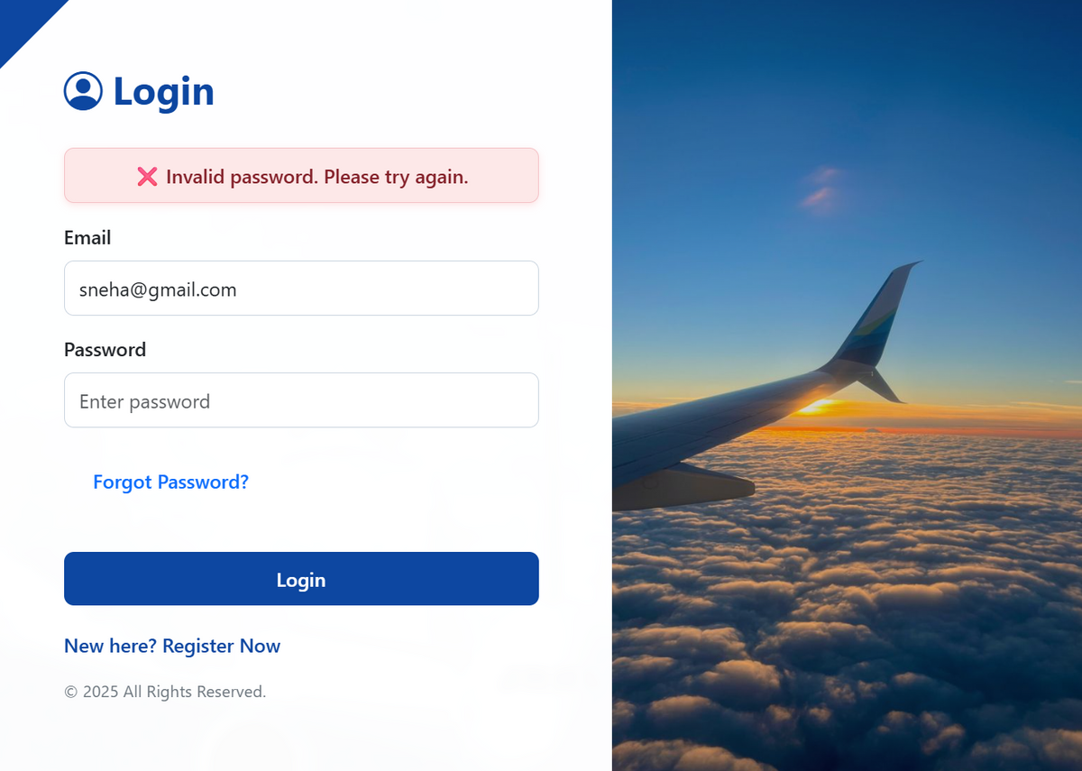
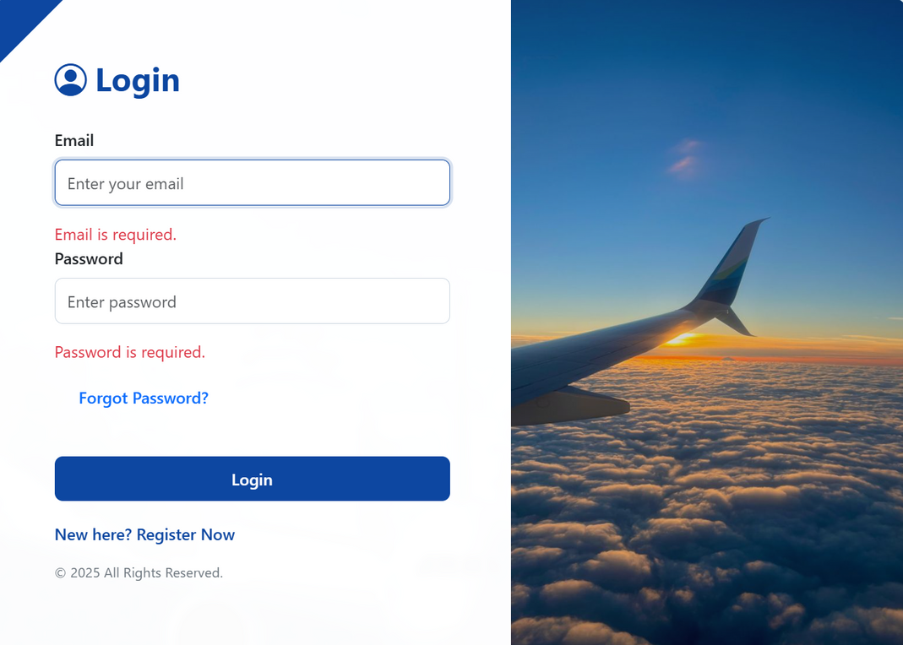
Displays an error message when an incorrect password is entered during login.
Shows validation alerts when mandatory fields like email and password are left empty.

Slide 9
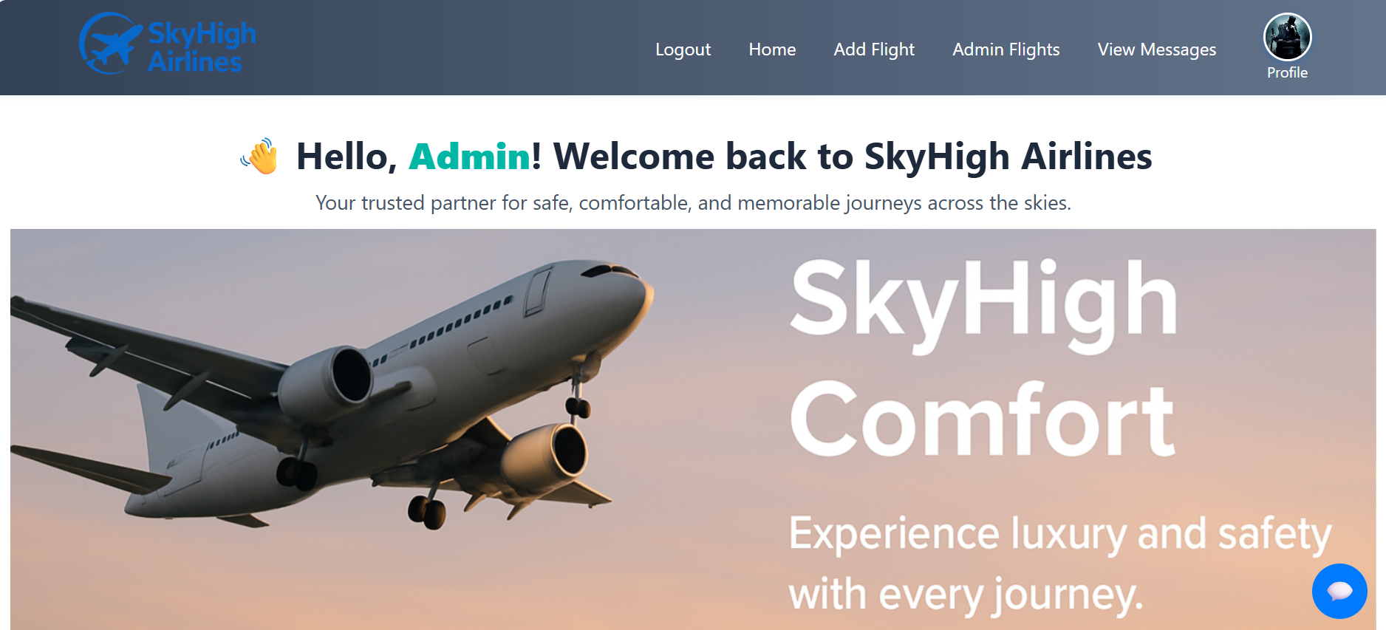
ADMIN DASHBOARD

Slide 10
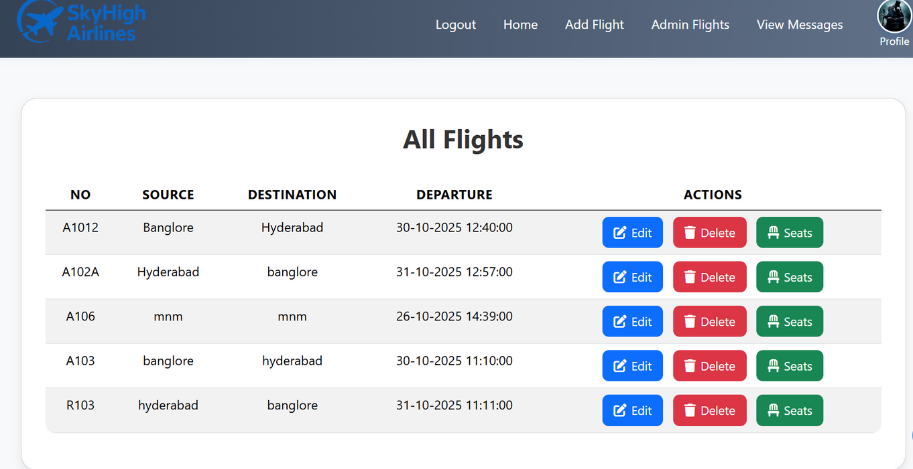
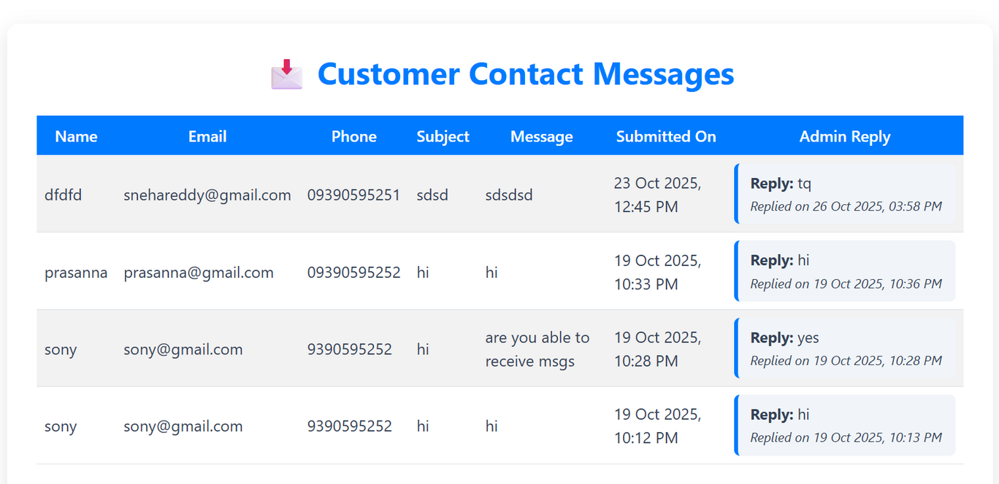
The admin can view, edit, delete, or manage seat details for all available flights.
The admin can view customer messages and send replies directly from the dashboard.

Slide 11
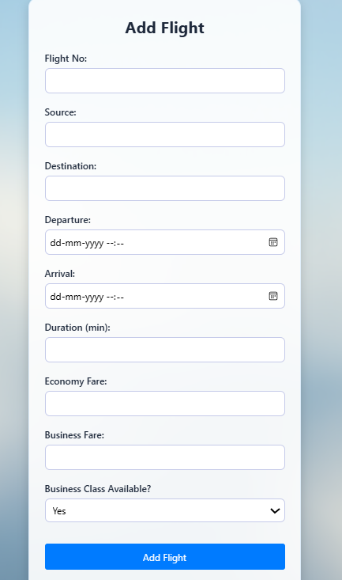
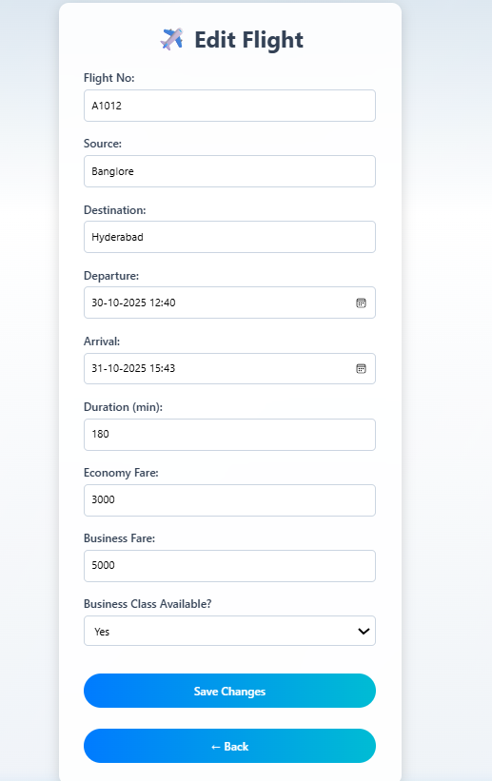
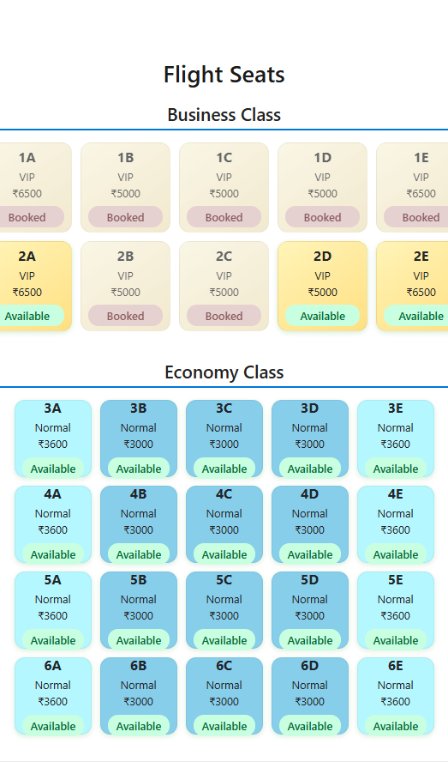
ADMIN ACTIONS

Slide 12
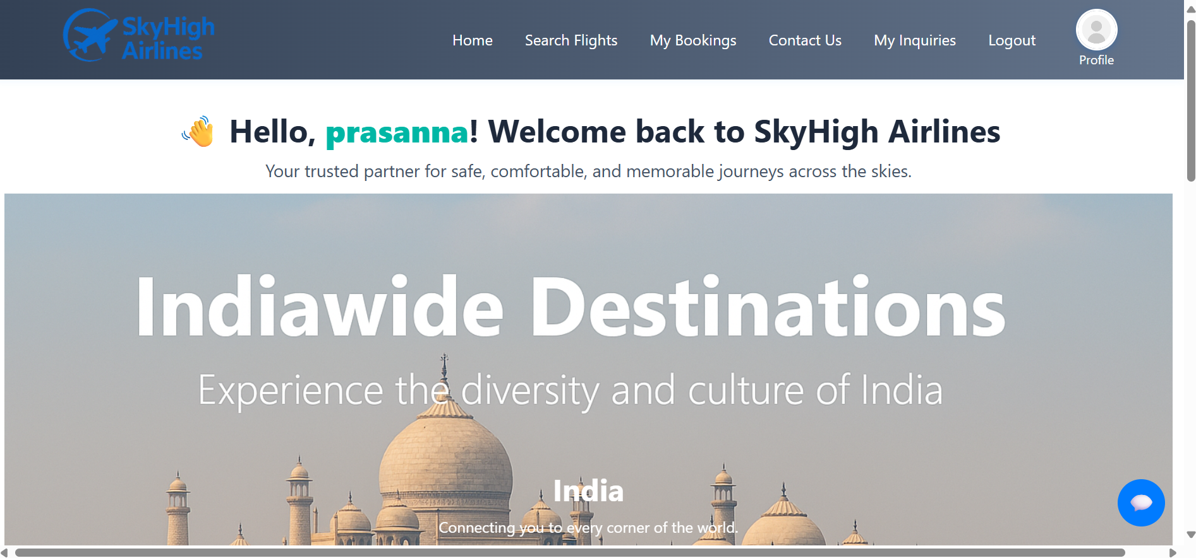
USER LOGIN

Slide 13
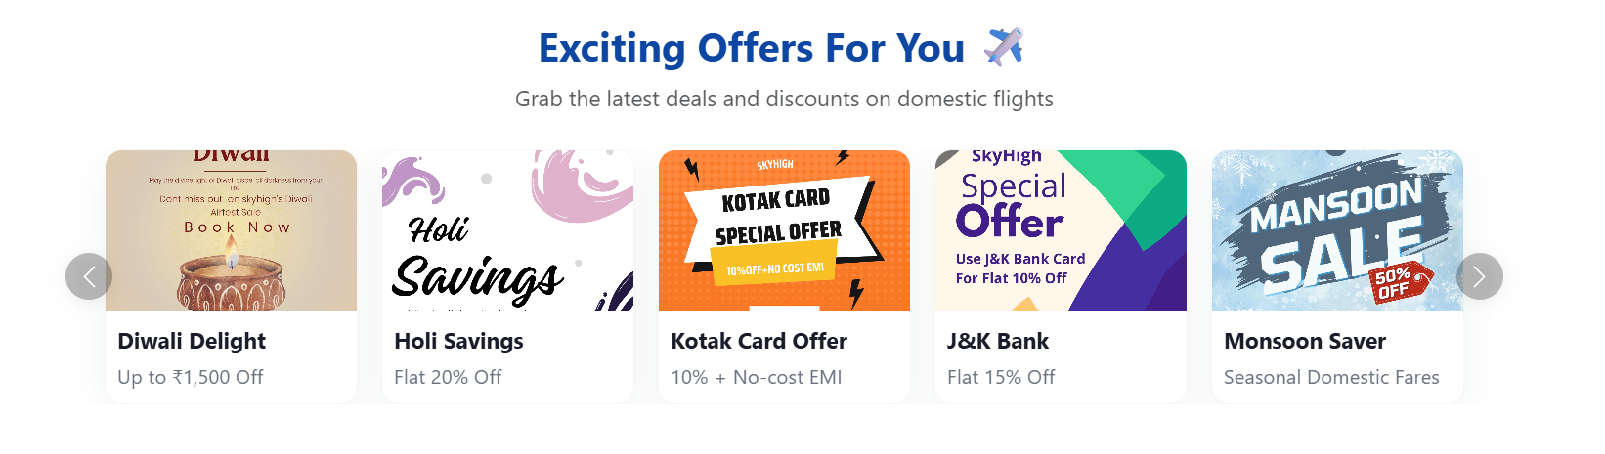
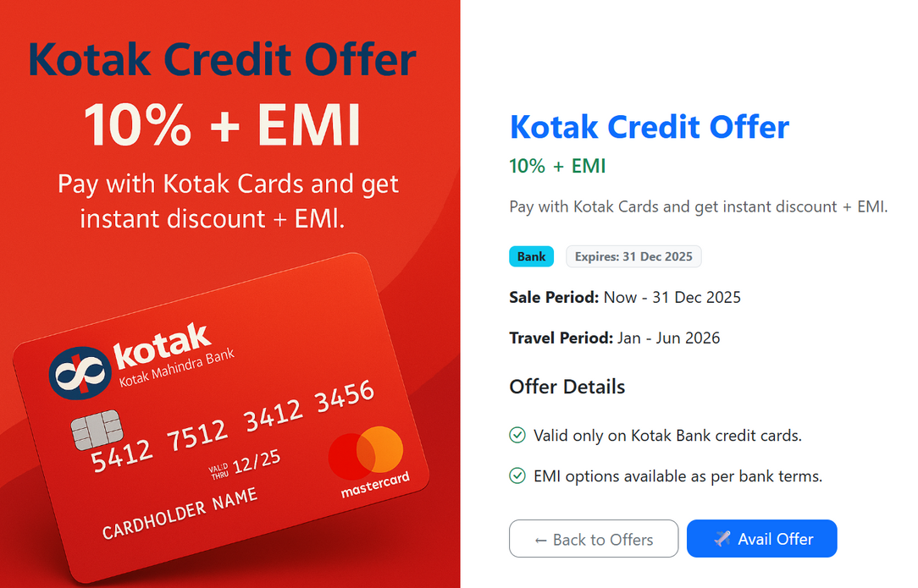
OFFERS
Users can view exciting flight offers, and clicking on any offer opens a detailed page with complete information and terms.

Slide 14
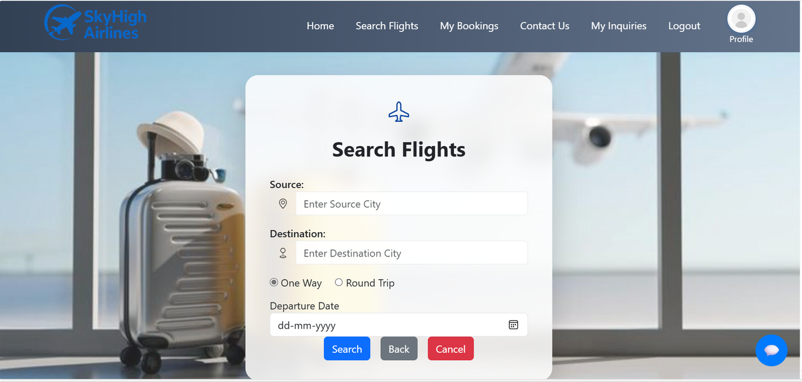
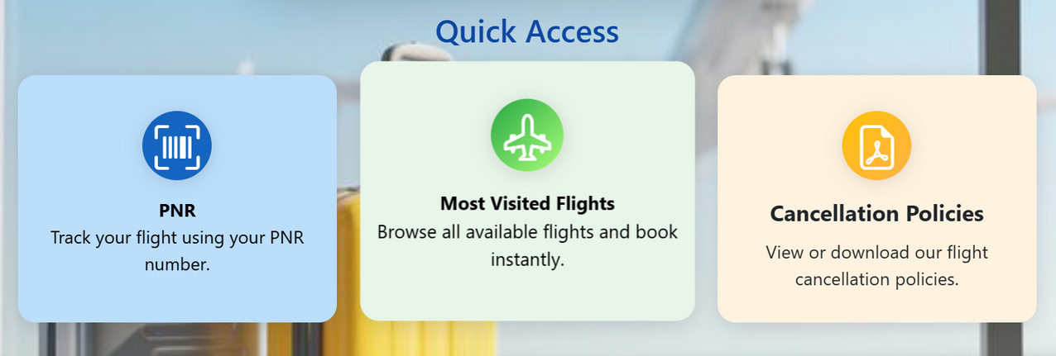
SEARCH FLIGHTS

Slide 15
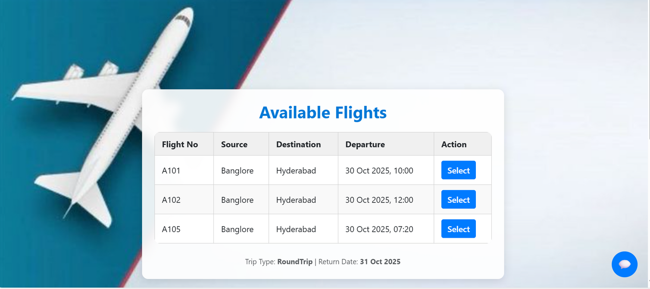
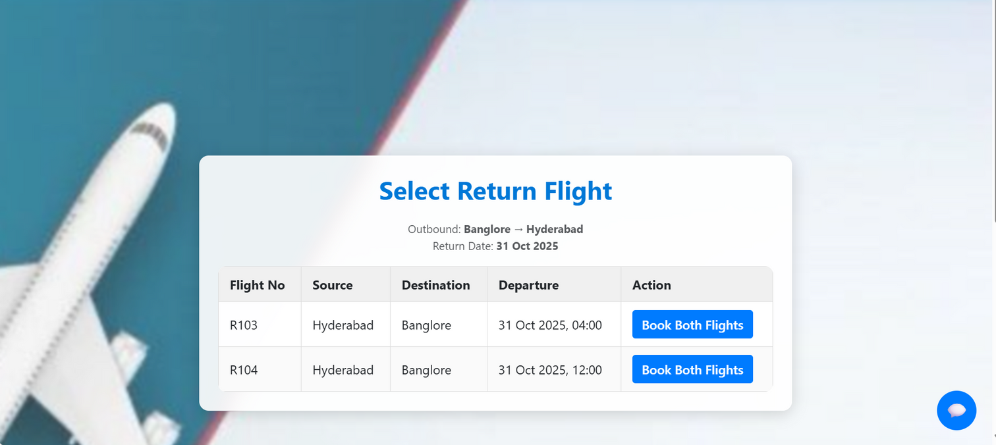
For a One-Way Trip, available outbound flights with details and a Select option are shown.
For a Round Trip, once the outbound flight is selected, the system displays return flights for the chosen route and date, allowing users to book both flights together easily.

Slide 16
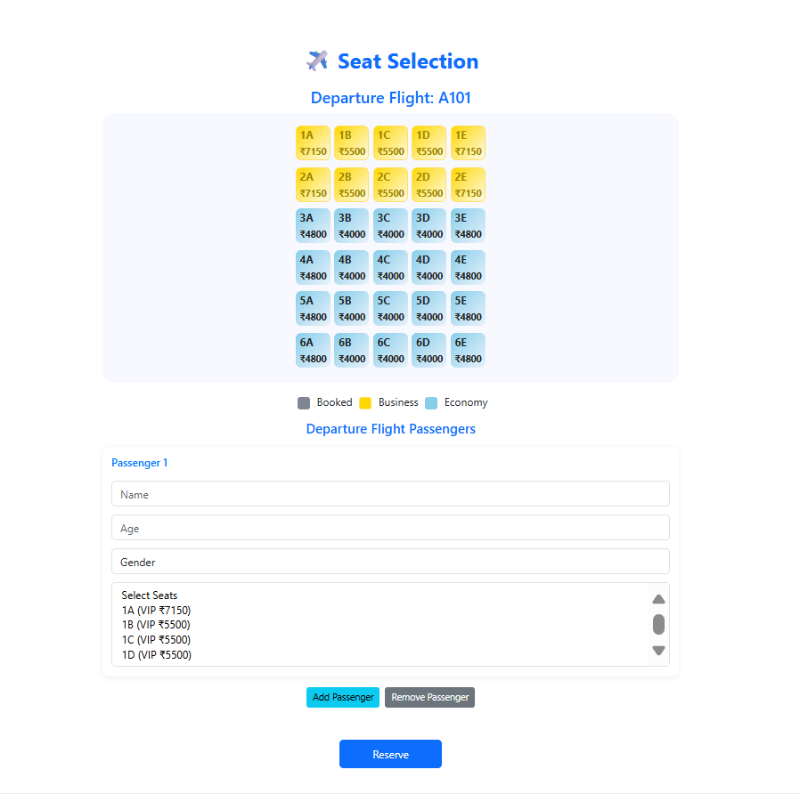
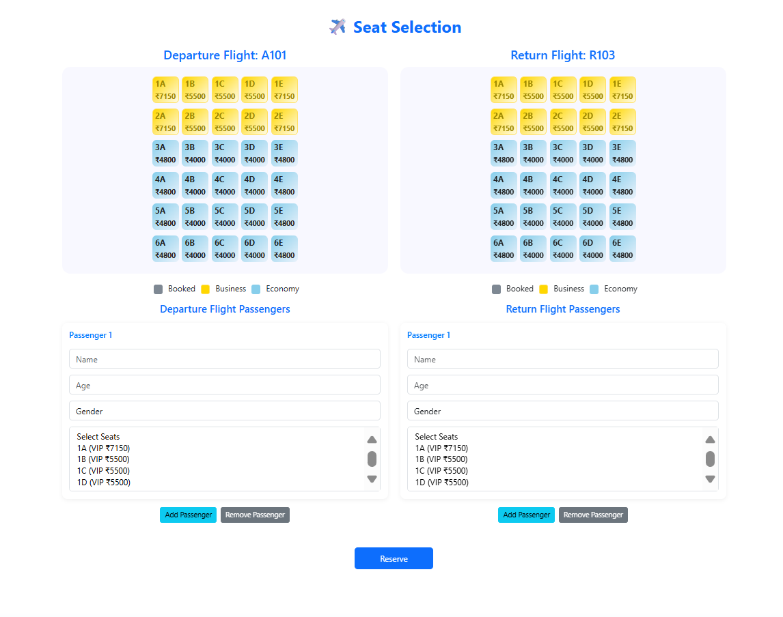
Seat selection Page for One-way and Round-trip

Slide 17
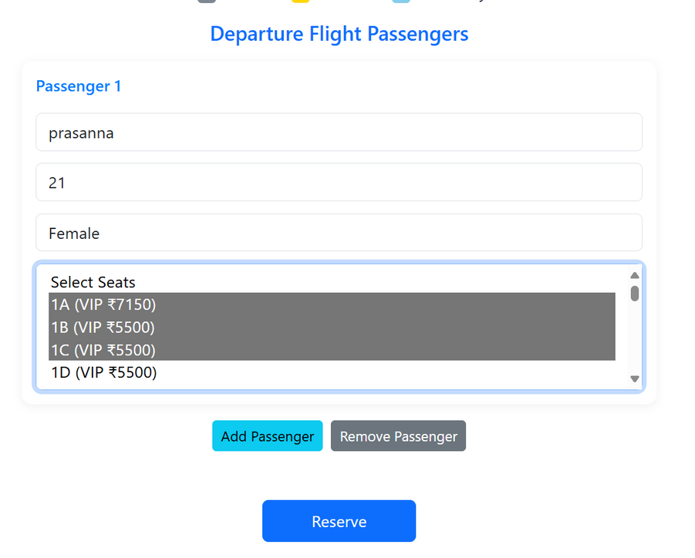
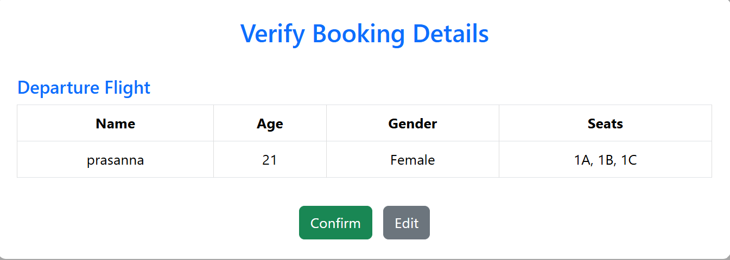
Users can enter passenger details and select multiple seats for a single booking. We can add and remove n number of passengers.
Displays a summary of entered details for users to verify and confirm before final booking

Slide 18
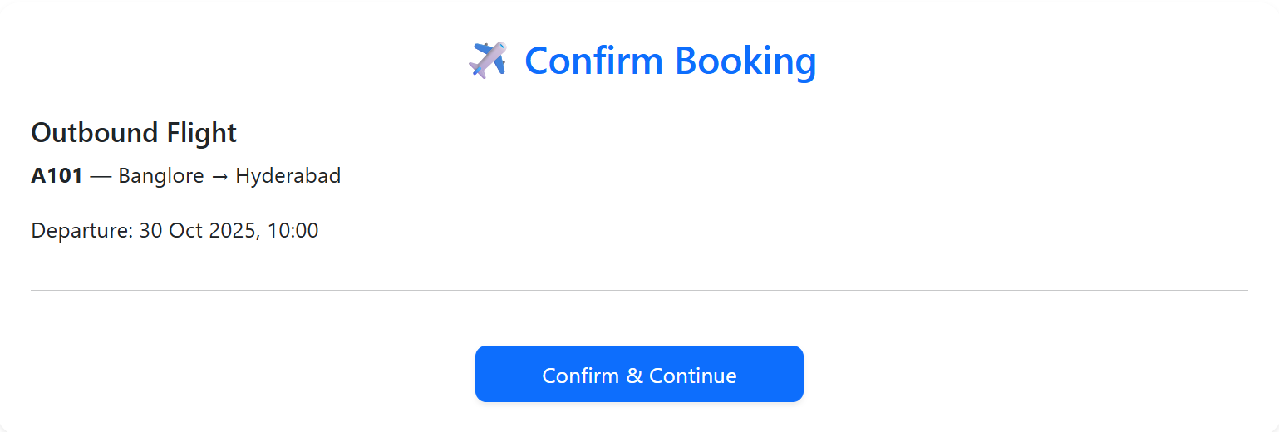
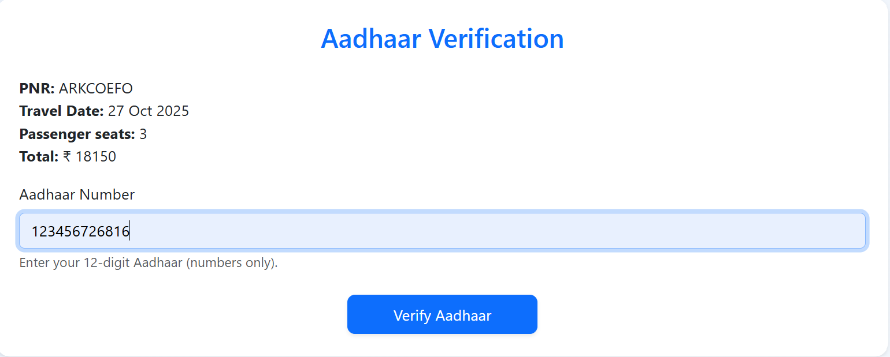
Displays flight details for final confirmation before proceeding to the next step.
Ensures passenger identity verification by validating the entered Aadhaar number.

Slide 19
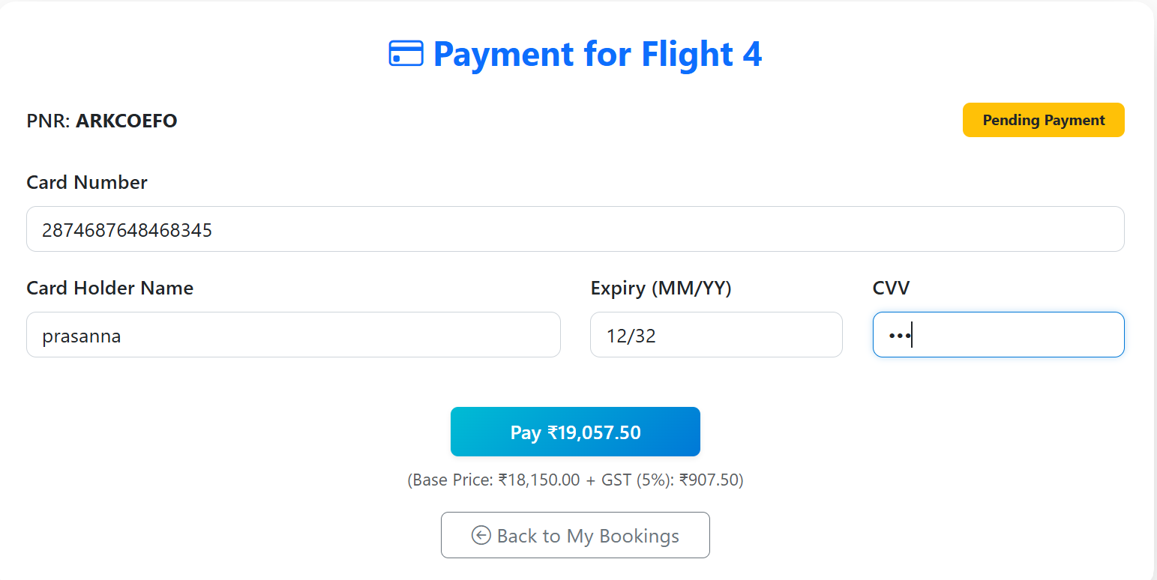
PAYMENT PAGE

Slide 20
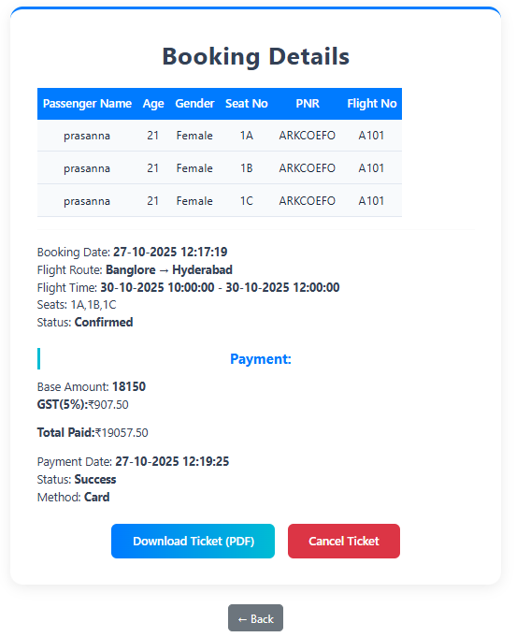
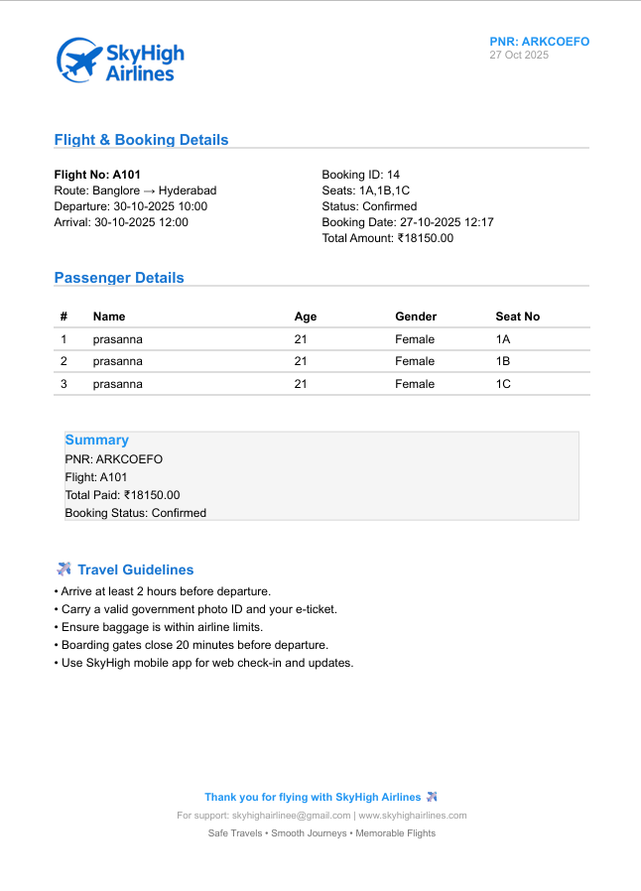
Once the ticket is successfully booked, the booking details including passenger, flight, and payment information are displayed, and the user can download the confirmed ticket in PDF format.

Slide 21
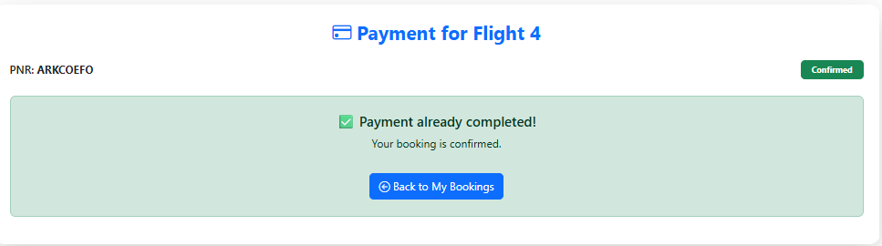
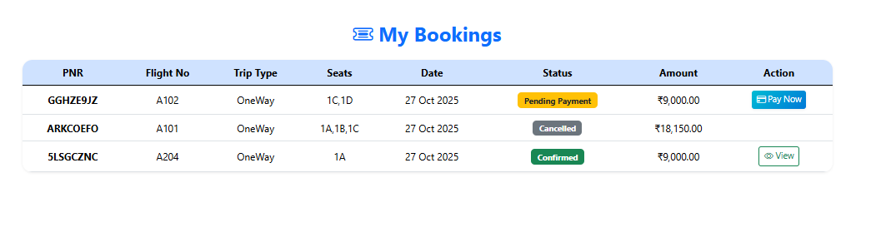
Once the ticket booking is successful, a confirmation message is displayed indicating that payment has been completed.
Displays all user bookings with their current status — Confirmed, Cancelled, or Pending Payment.

Slide 22
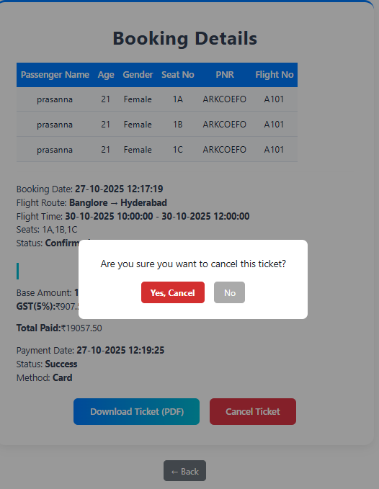
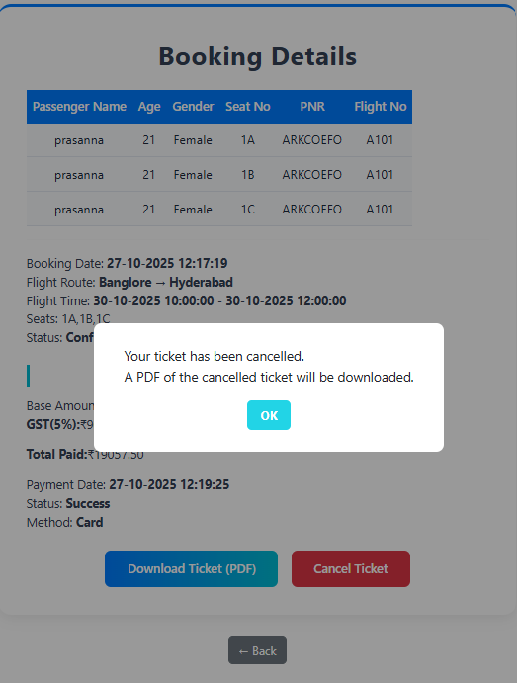
When the user chooses to cancel a booking, a confirmation popup appears, and upon confirmation, the ticket is cancelled and a PDF of the cancelled ticket is automatically downloaded.

Slide 23
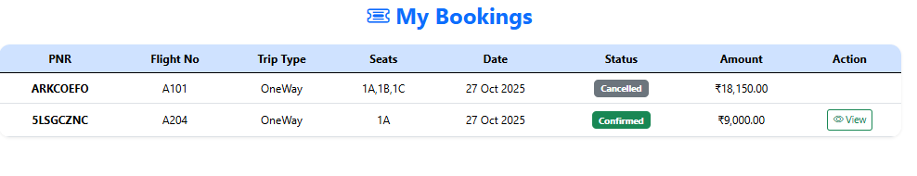
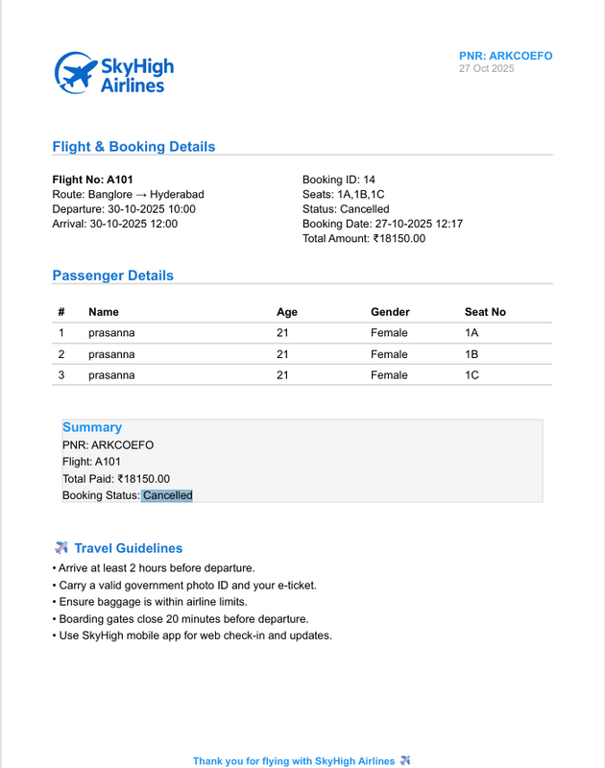
When a ticket is cancelled, it appears in the ‘My Bookings’ page with a Cancelled status, and users can download a PDF of the cancelled ticket showing all flight and passenger details.
For confirmed tickets, clicking on the View button displays the complete booking details including flight, passengers, and payment information.

Slide 24
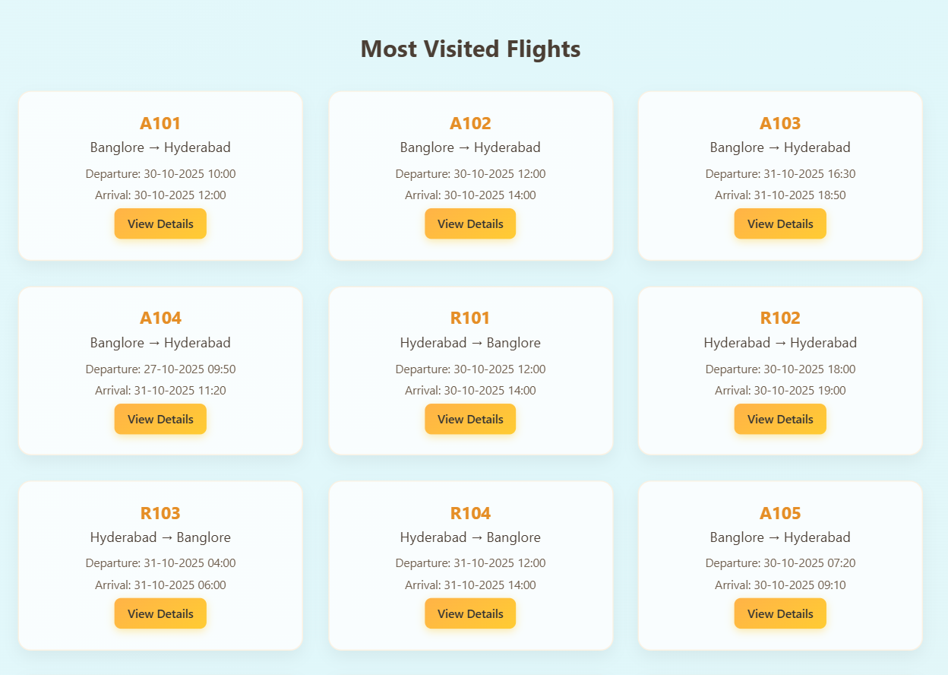
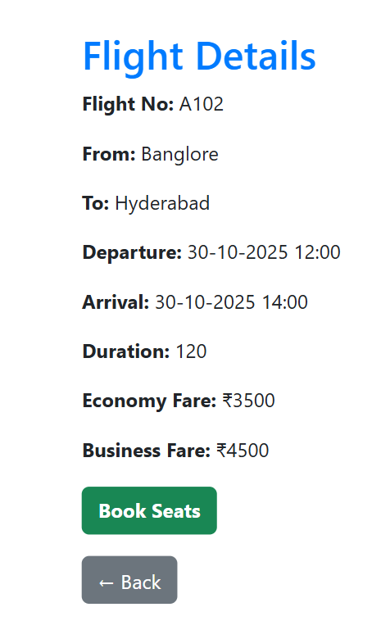
MOST VISITED FLIGHTS PAGE

Slide 25
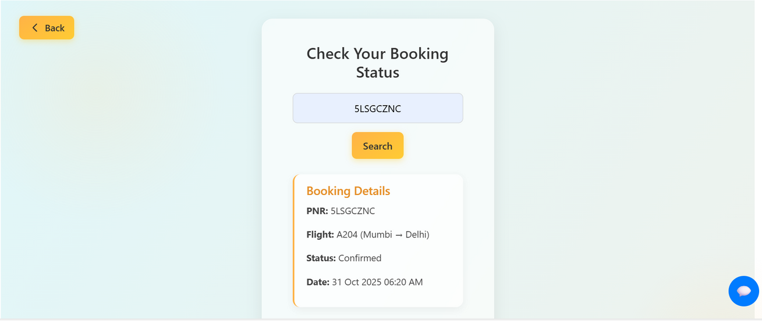
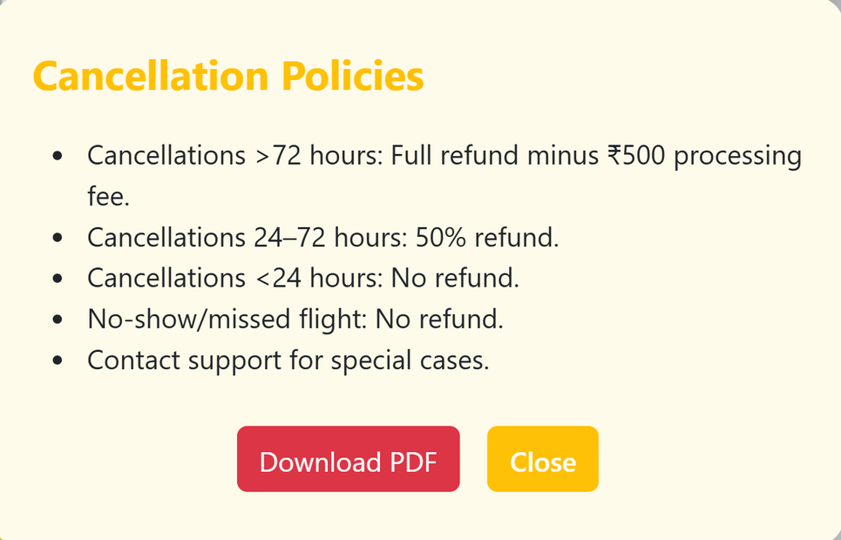
Users can check their booking status by entering the PNR number to view flight and confirmation details.
Displays the airline’s cancellation and refund policies, allowing users to download them as a PDF for reference.

Slide 26
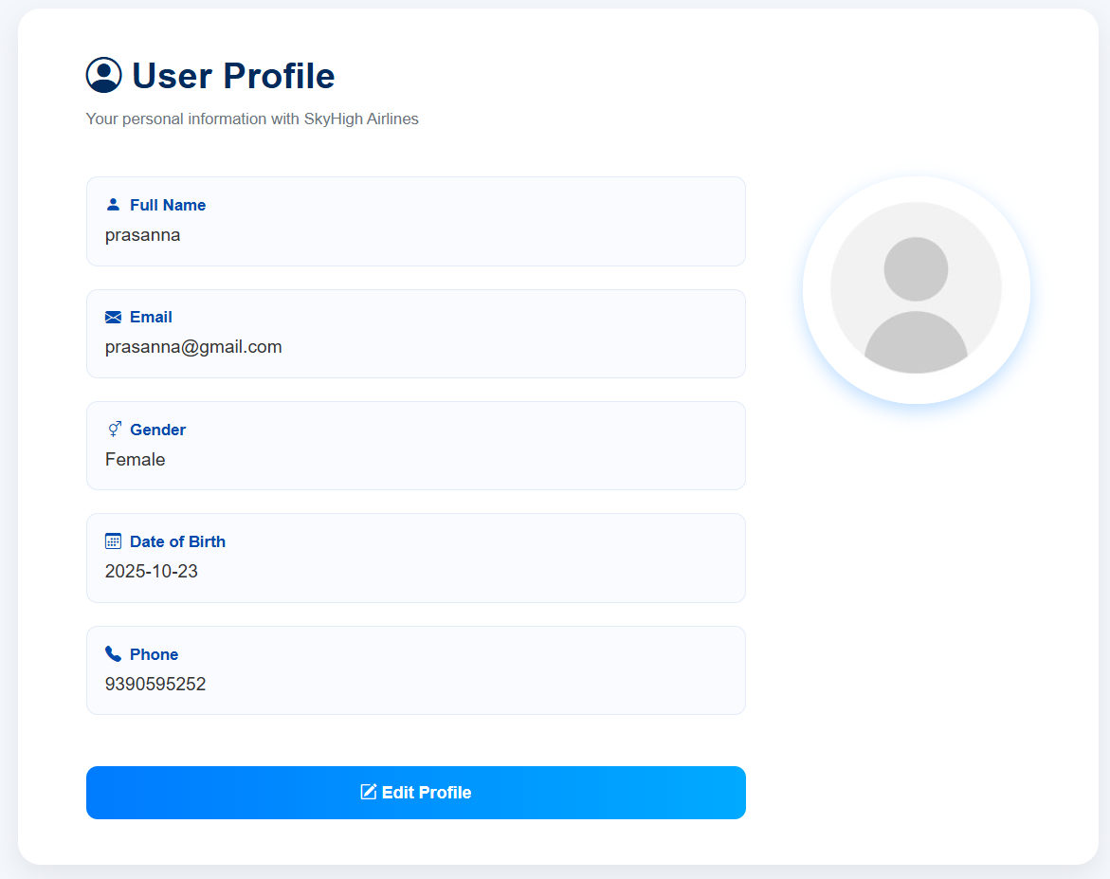
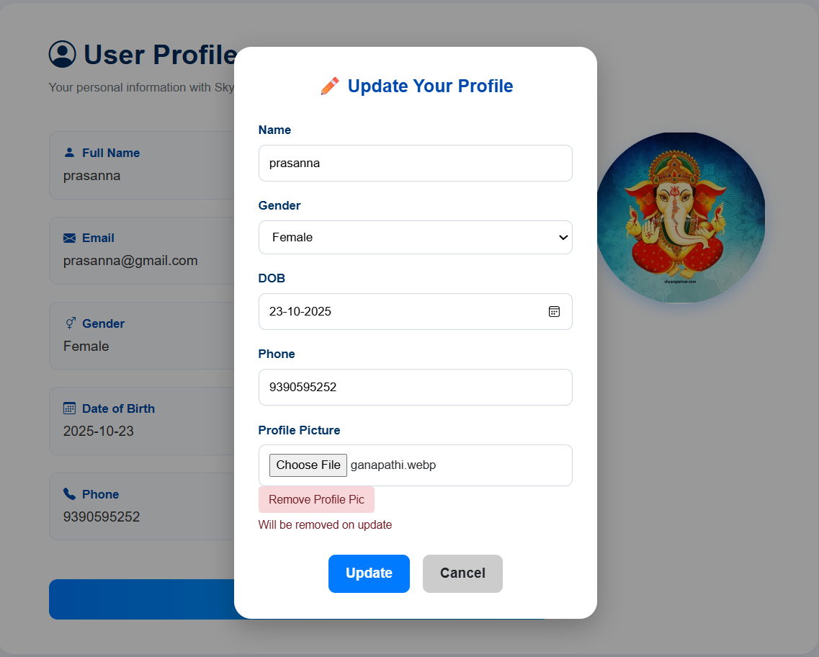
USER PROFILE

Slide 27
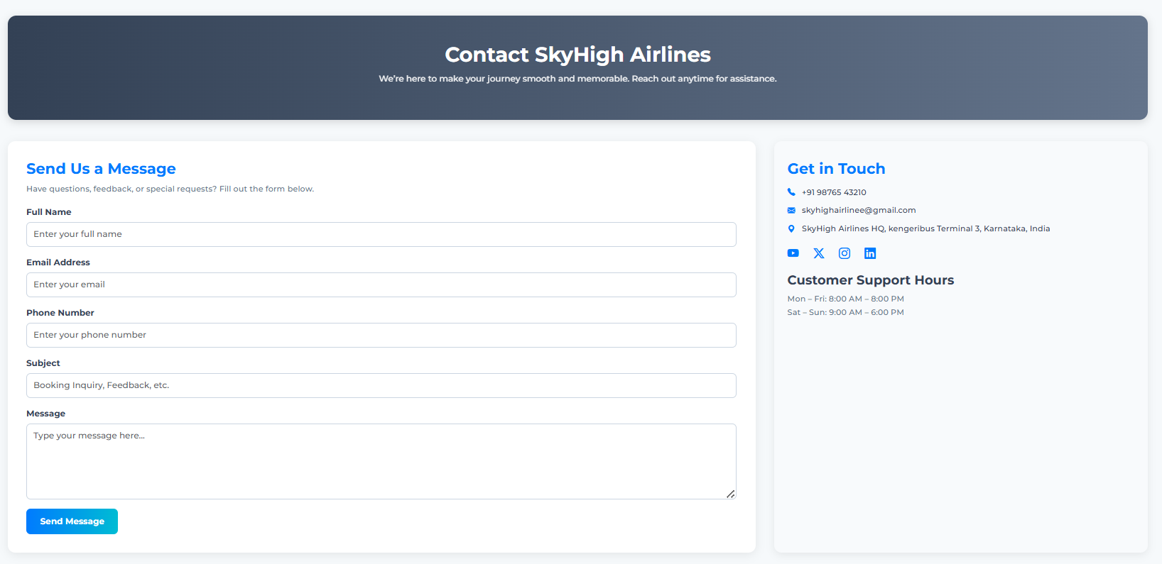
CONTACT US PAGE

Slide 28
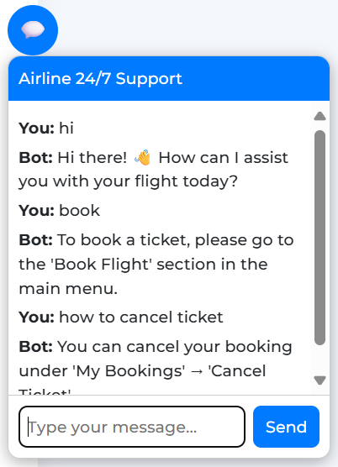
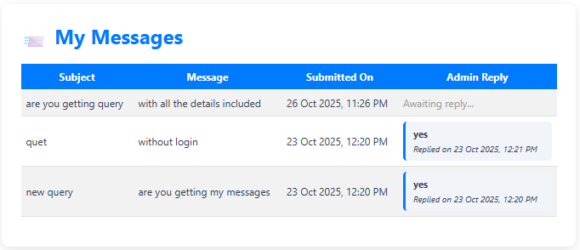
CHATBOT AND MY INQUIRES PAGES
An interactive chatbot provides 24/7 support, helping users with tasks like booking flights, checking status, and cancelling tickets.
Users can view all their submitted queries and see admin replies along with the response time and date.

Slide 29


